Slide 1



Noida Institute of Engineering and Technology, Greater Noida
Syntax Directed Translation
Unit: 3
Subject:
Compiler Design()
Rohit Chaudhary
Assistant Professor
CSE Department
Course Details B Tech CSE 5th Sem

Slide 2
Brief Introduction
Research Publications

Slide 3
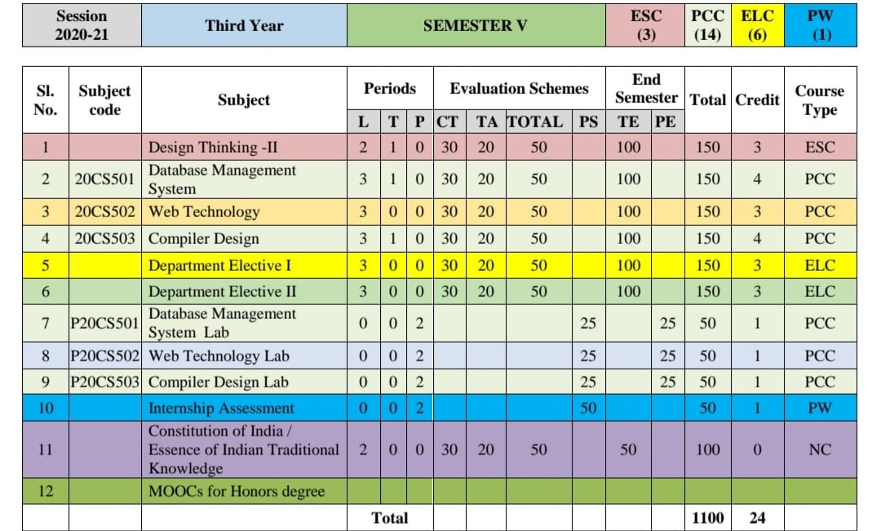
Evaluation Scheme

Slide 4
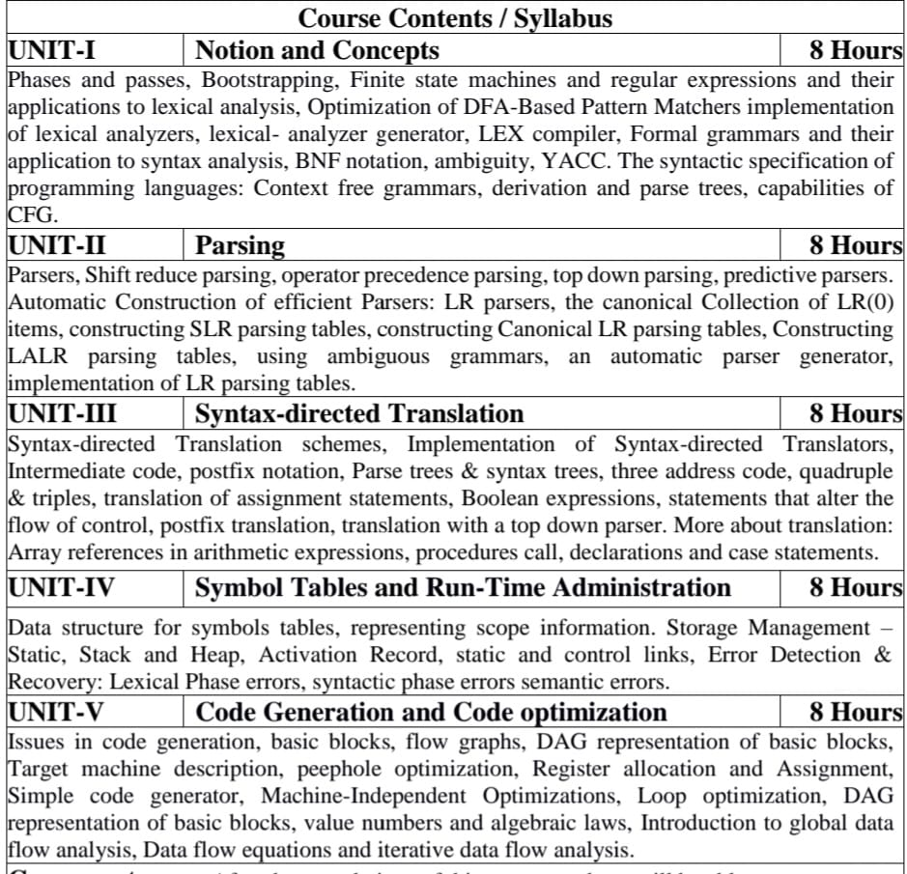
Syllabus

Slide 5
Branch wise Applications
Computer Science/ IT
Compiler technology can be used to translate the binary code for one machine to that of another, allowing a machine to run programs originally compiled for another instruction set. Binary translation technology has been used by various computer companies to increase the availability of software for their machines
Implementations of High Level Programming
Optimization of Computer Architecture
Design of New Computer Architecture
Program Translation
Software Productive tools

Slide 6
Course Objectives
Introduce students to the concepts underlying the design and implementation of language processors. More specifically, by the end of the course, students will be able to answer these questions:
What language processors are, and what functionality do they provide to their users?
What core mechanisms are used for providing such functionality?
How are these mechanisms implemented?
Apart from providing a theoretical background, the course places a special emphasis in practical issues in designing language processors.

Slide 7
Course Outcomes
CO1: To have the knowledge of patterns, tokens, regular expressions and finite automata to develop a scanner or lexical analyzer.
CO2: To design and develop various parser by parsing LL parser and LR parser
CO3: To apply various design & conduct experiments for Intermediate Code Generation in compiler.
CO4: To design and develop various Data structure for symbols tables and Error Detection & Recovery at every phases
CO5: To apply various new code optimization techniques to improve the performance of a program in terms of speed & space.

Slide 8
Program Outcomes (PO)
PO1: Engineering Knowledge
PO2: Problem Analysis
PO3: Design/Development of solutions
PO4: Conduct Investigations of complex problems
PO5: Modern tool usage
PO6: The engineer and society
PO7: Environment and sustainability
PO8: Ethics
PO9: Individual and team work
PO10: Communication
PO11: Project management and finance
PO12: Life-long learning

Slide 9
CO-PO Mapping
 | PO1 | PO2 | PO3 | PO4 | PO5 | PO6 | PO7 | PO8 | PO9 | PO10 | PO11 | PO12
KCS-502.1 | 3 | 3 | 3 | 3 | 3 | 1 | 1 | 1 | 3 | 1 | 2 | 2
KCS-502.2 | 3 | 3 | 3 | 3 | 3 | 1 | 1 | 1 | 3 | 1 | 2 | 2
KCS-502.3 | 3 | 3 | 3 | 3 | 3 | 1 | 1 | 1 | 3 | 1 | 2 | 2
KCS-502.4 | 3 | 2 | 3 | 3 | 3 | 1 | 1 | 1 | 3 | 1 | 2 | 2
KCS-502.5 | 3 | 2 | 3 | 3 | 3 | 1 | 1 | 1 | 3 | 1 | 2 | 2
AVG | 3 | 2.6 | 3 | 3 | 3 | 1 | 1 | 1 | 3 | 1 | 2 | 2

Slide 10
Program Specific Outcomes (PSO)
PSO1: Work as a software developer, database administrator, tester or networking engineer for providing solutions to the real world and industrial problems
PSO2:Apply core subjects of information technology related to data structure and algorithm, software engineering, web technology, operating system, database and networking to solve complex IT problems.
PSO 3:Practice multi-disciplinary and modern computing techniques by lifelong learning to establish innovative career.
PSO 4:Work in a team or individual to manage projects with ethical concern to be a successful employee or employer in IT industry

Slide 11
CO-PSO Mapping
 | PSO1 | PSO2 | PSO3 | PSO4
KCS502.1 | 3 | 3 | 3 | 1
KCS502.2 | 3 | 3 | 3 | 1
KCS502.3 | 3 | 3 | 3 | 1
KCS502.4 | 3 | 3 | 3 | 1
KCS502.5 | 3 | 3 | 3 | 1
AVG | 3 | 3 | 3 | 1

Slide 12
Program Educational Objectives
PEO1: To have an excellent scientific and engineering breadth so as to
comprehend, analyze, design and provide sustainable solutions for
real-life problems using state-of-the-art technologies.
PEO2:To have a successful career in industries, to pursue higher studies or
to support enterpreneurial endeavors and to face global challenges.
PEO3:To have an effective communication skills, professional attitude,
ethical values and a desire to learn specific knowledge in emerging
trends, technologies for research, innovation and product
development and contribution to society.
PEO4: To have life-long learning for up-skilling and re-skilling for
successful professional career as engineer, scientist, enterpreneur
and bureaucrat for betterment of society

Slide 13
Result Analysis
Subject Result: 98 %
Department Result: 98 %
Faculty-Wise Result:
Ms. Arti Bahuguna(B): 100%
Ms. Arti Bahuguna(C): 98.59%
Ms. Mohini Chakravarti(A): 97.06%
Ms. Mohini Chakravarti(D): 100%

Slide 14
End Semester Question Paper Template
B TECH
(SEM-V) THEORY EXAMINATION 20__-20__
COMPILER DESIGN
Time: 3 Hours Total Marks: 100
Note: 1. Attempt all Sections. If require any missing data; then choose suitably.
SECTION A
Attempt all questions in brief. 2 x 10 = 20
Q.No. | Question | Marks | CO
1 |  | 2
2 |  | 2
. |  | .
10 |  | 2

Slide 15
End Semester Question Paper Templates
SECTION B
2. Attempt any three of the following: 3 x 10 = 30
SECTION C
3. Attempt any one part of the following: 1 x 10 = 10
Q.No. | Question | Marks | CO
1 |  | 10
2 |  | 10
. |  | .
5 |  | 10
Q.No. | Question | Marks | CO
1 |  | 10
2 |  | 10

Slide 16
End Semester Question Paper Templates
4. Attempt any one part of the following: 1 x 10 = 10
5. Attempt any one part of the following: 1 x 10 = 10
6. Attempt any one part of the following: 1 x 10 = 10
Q.No. | Question | Marks | CO
1 |  | 10
2 |  | 10
Q.No. | Question | Marks | CO
1 |  | 10
2 |  | 10
Q.No. | Question | Marks | CO
1 |  | 10
2 |  | 10

Slide 17
End Semester Question Paper Templates
7. Attempt any one part of the following: 1 x 10 = 10
Q.No. | Question | Marks | CO
1 |  | 10
2 |  | 10

Slide 18
Prerequisite
Algorithms
Languages and machines
Operating systems
Computer architectures
Theory of Automata

Slide 19
Recap
Grammar symbols are associated with attributes
Translation Schemes gives a little bit information about implementation details.

Slide 20
Unit Content
Syntax Directed Translation
Attributes
Synthesize attributes
Inherit attributes
Intermediate Code Representation
Syntax Tree
Three Address Code
Generating three-address code for Boolean Expression
Translation of Control Flow Statements
Translation of simple switch case
Back Patching

Slide 21
Unit Objective(CO3)
Introduce students to the concepts underlying the design of intermediate code generation in the process of designing the compiler .

Slide 22
Topic Objective(CO3)
Introduce students to the concepts of syntax directed translation
The attributes are evaluated by the semantic rules used in SDT

Slide 23
Syntax-Directed Translation(CO3)
Grammar symbols are associated with attributes to associate information with the programming language constructs that they represent.
Values of these attributes are evaluated by the semantic rules associated with the production rules.
Evaluation of these semantic rules:
may generate intermediate codes
may put information into the symbol table
may perform type checking

Slide 24
Syntax-Directed Translation
When we associate semantic rules with productions, we use two notations:
Syntax-Directed Definitions
Translation Schemes
Syntax-Directed Definitions:
give high-level specifications for translations
hide many implementation details such as order of evaluation of semantic actions.
We associate a production rule with a set of semantic actions, and we do not say when they will be evaluated.

Slide 25
Syntax-Directed Translation
Translation Schemes:
indicate the order of evaluation of semantic actions associated with a production rule.
In other words, translation schemes give a little bit information about implementation details.

Slide 26
Attributes(CO3)
Attribute grammar is a special form of context-free grammar where some additional information (attributes) are appended to one or more of its non-terminals in order to provide context-sensitive information.
Each attribute has well-defined domain of values, such as integer, float, character, string, and expressions.
E → E + T { E.value = E.value + T.value }
Semantic attributes may be assigned to their values from their domain at the time of parsing and evaluated at the time of assignment or conditions.
Based on the way the attributes get their values, they can be broadly divided into two categories : synthesized attributes and inherited attributes.

Slide 27
Synthesized attributes(CO3)
These attributes get values from the attribute values of their child nodes.
Each of the non-terminals has a single synthesized attribute, called val.
An SDD that involves only synthesized attributes is called S-attributed
Each rule computes an attribute for the non-terminal at the head of a production from attributes taken from the body of the production.

Slide 28
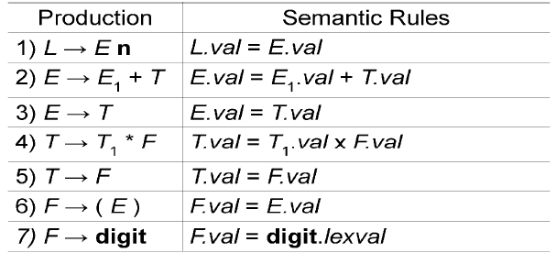
Synthesized attributes
A parse tree, showing the value(s) of its attribute(s) is called an annotated parse tree.
With synthesized attributes, evaluate attributes in bottom-up order.

Slide 29
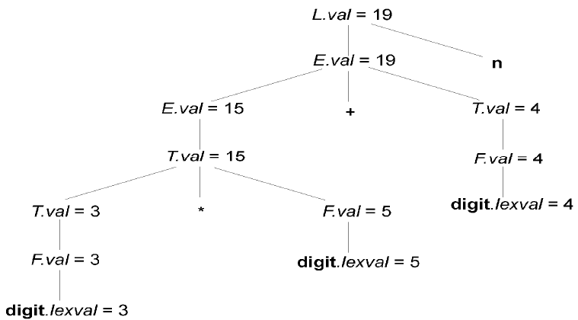
Synthesized attributes
Annotated Parse Tree of 3*5+4n

Slide 30
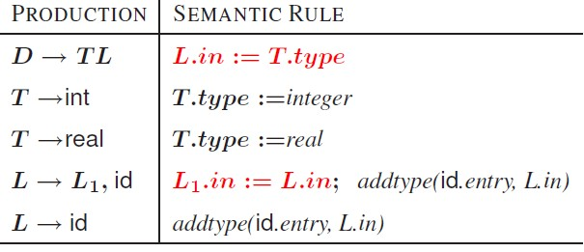
Inherited attributes(CO3)

Slide 31
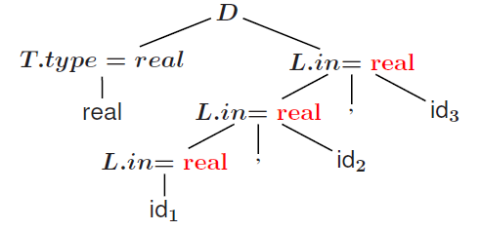
Inherited attributes
Annotated parse tree of real id, id, id

Slide 32
Recap
An SDD that involves only synthesized attributes is called S-attributed
An SDD that involves only inherit attributes is called L-attributed
A parse tree, showing the value(s) of its attribute(s) is called an annotated parse tree

Slide 33
Topic Objective(CO3)
Introduce students to the concepts of syntax directed translation
Example of evaluating the SDT with the help of attributes

Slide 34
Implementation of desk calculator(CO3)
Production Semantic Actions
S →E$ {print val[Top]}
E→E+E {val[Top]}= val[Top-1]+ val[Top]}
E→E*E {val[Top]}= val[Top-1]* val[Top]}
E→I { }
I→I.digit {val[Top]}= val[Top-1]*10+lex.val}
I→digit {val[Top]}= val[Top]=lex.val}

Slide 35
Implementation of desk calculator
Parse Tree | value Stack | input | action
… | … | 3*5+4$ | shift
3 | … | 3*5+4$ | reduce I→digit
I | 3 | 3*5+4$ | shift
E | 3 | *5+4$ | shift
E* | 3 | 5+4$ | shift
E*5 | 3 | +4$ | reduce I→digit
E*I | 3, 5 | +4$ | reduce E→E*E
E | 15 | +4$ | shift
E+ | 15 | 4$ | shift
E+4 | 15 | $ | reduce I→digit
E+I | 15,4 | $ | reduce E→E+E
E | 19 | $ | shift
E$ | 19 | … | reduce S→E$
S | print = 19 | …. | ….

Slide 36
Recap
Implementation of desk Calculator

Slide 37
Topic Objective(CO3)
Introduce students to the concepts of intermediate code generation
Very useful in the concept of how high level program is stored in address form

Slide 38
Intermediate Code representation(CO3)
Front end of a compiler is efficient and can be automated
Back end is generally hard to automate and finding the optimum solution requires exponential time
Intermediate code generation can affect the performance of the back end
Goal: Generate a Machine Independent Intermediate Form that is Suitable for Optimization and Portability
Facilitates retargeting: enables attaching a back end for the new machine to an existing front end
Enables machine-independent code optimization

Slide 39
Intermediate Code representation
Graphical representations e.g. Abstract Syntax Tree
Postfix notation: operations on values stored on operand stack (similar to JVM byte code)
Three-address code: (e.g. triples and quads)
x := y op z
Two-address code:
x := op y

Slide 40
Syntax Trees for Expressions(CO3)
Functions will create nodes for the syntax tree
mknode (op, left, right) – creates an operator node with label op and pointers left and right which point to operand nodes
mkleaf(id, entry) – creates an identifier node with label
id and a pointer to the appropriate symbol table entry
Mkleaf(num, val) – creates a number node with label num
and value val
Each function returns pointer to created node

Slide 41
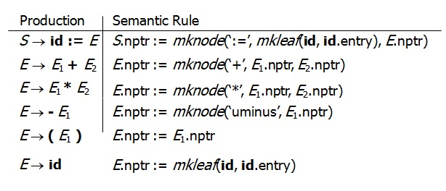
Syntax-Directed Translation of Abstract Syntax Trees(CO3)

Slide 42
Recap
Graphical representations e.g. Abstract Syntax Tree
Postfix notation: operations on values stored on operand stack (similar to JVM byte code)
Three-address code: (e.g. triples and quads)
x := y op z
Two-address code:
x := op y
Syntax Tree
mknode (op, left, right) – creates an operator node with label op and pointers left and right which point to operand nodes
mkleaf(id, entry) – creates an identifier node with label

Slide 43
Topic Objective(CO3)
Introduce students to the concepts of intermediate code generation
Here we will discuss different methods to generate the three address code and their storing concept

Slide 44
Three address code(CO3)
In a three address code there is at most one operator at the right side of an instruction
Example:
+
t1 = b – c
t2 = a * t1
t3 = a + t2
t4 = t1 * d
t5 = t3 + t4
+
*
*
d
a
b
c

Slide 45
Forms of three address instructions(CO3)
x = y op z
x = op y
x = y
goto L
if x goto L and ifFalse x goto L
if x relop y goto L
Procedure calls using:
param x
call p,n
y = call p,n
x = y[i] and x[i] = y
x = &y and x = *y and *x =y

Slide 46
Data structures for three address codes(CO3)
Quadruples
Has four fields: op, arg1, arg2 and result
Triples
Temporaries are not used and instead references to instructions are made
Indirect triples
In addition to triples we use a list of pointers to triples

Slide 47
Three address codes Example(CO3)
Three address code
Example
b * minus c + b * minus c
t1 = minus c
t2 = b * t1
t3 = minus c
t4 = b * t3
t5 = t2 + t4
a = t5
Quadruples
Triples
Indirect Triples
op | arg1 | arg1 | result
minus | c |  | t1
* | b | t1 | t2
minus | c |  | t3
* | b | t3 | t4
+ | t2 | t4 | t5
= | t5 |  | a
 | op | arg1 | arg1
0 | minus | c
1 | * | b | 0
2 | minus | c
3 | * | b | 2
4 | + | 1 | 3
5 | = | a | 4
 | op
0 | 0
1 | 1
2 | 2
3 | 3
4 | 4
5 | 5
 | op | arg1 | arg1
0 | minus | c
1 | * | b | 0
2 | minus | c
3 | * | b | 2
4 | + | 1 | 3
5 | = | a | 4

Slide 48
Quadruples Example(CO3)
a := b * -c + b * -c
 | op | arg1 | arg2 | result
(0) | uminus | c |  | t1
(1) | * | b | t1 | t2
(2) | uminus | c |  | t3
(3) | * | b | t3 | t4
(4) | + | t2 | t4 | t5
(5) | := | t5 |  | a

Slide 49
Triples Example(CO3)
a := b * -c + b * -c
 | op | arg1 | arg2
(0) | uminus | c
(1) | * | b | (0)
(2) | uminus | c
(3) | * | b | (2)
(4) | + | (1) | (3)
(5) | := | a | (4)
Result is implicit in triples

Slide 50
Indirect triples(CO3)
a := b * -c + b * -c
 | op |  | op | arg1 | arg2
(0) | (14) | (14) | uminus | c
(1) | (15) | (15) | * | b | (14)
(2) | (16) | (16) | uminus | c
(3) | (17) | (17) | * | b | (16)
(4) | (18) | (18) | + | (15) | (17)
(5) | (19) | (19) | assign | a | (18)

Slide 51
Topic Objective(CO3)
Introduce students to the concepts of intermediate code generation and SDT in combine
How the semantic rules (SDT) are associated with three address code(intermediate code )

Slide 52
syntax-directed translation into three-address code(CO3)
semantic rules
S.code := E.code ‖gen( id.place ‘:=’ E.place)
E.place := newtemp;
E.code := E₁.code ‖E₂.code ‖
gen( E.place ‘:=’ E₁.place ‘+’E₂. place)
Same as ‘+’
production
S→ id :=E
E→ E₁ +E₂
E→ E_{1 *} E₂
E → -E₁
E.place := newtemp;
E.code := E₁.code ‖gen(E.place ‘:=’ ‘uminus’E₁. place)
E.place := E₁.place; E.code := E₁.code
E.place := id.place; E.code := ‘’
E → (E₁)
E→ id

Slide 53
Assignment: Example(CO3)
x = a * b + c * d - e * f;
t1 | = | e * f;
t2 | = | c * d;
t3 | = | t2 - t1;
t4 | = | a * b;
S
id
=
E
t5 = t4 + t3;
x = t5;
E
+
E
x
E
* E
E
-
E
id
id
E
*
E
* E
E
id
id
id
id
a
b
c
d
e
f

Slide 54
Boolean & Relational Values(CO3)
How should the compiler represent them?
Answer depends on the target machine
Two classic approaches
Numerical representation
Positional (implicit) representation
Correct choice depends on both context and ISA

Slide 55
SDT Scheme for Boolean Expressions(CO3)
Issue: Control Flow Introduces Complications
In Both Representations
Need to Know Address to Jump To in Some Cases
Solution: Two Additional Attributes
–
–
nextstat (Inherited) Indicates the next location to be generated
laststat (Synthesized) Indicates the last location filled
– As code is generated the attributes are filled with the correct value

Slide 56
Boolean Expression: Grammar and Actions(CO3)
E → false
{E.place = newtemp() E.code = {gen(E.place = 0)} E.laststat = E.nextstat + 1
}
{E.place = newtemp()
E.code = {gen(E.place = 1)} E.laststat = E.nextstat + 1
}
E → true

Slide 57
Boolean Expression: Grammar and Actions
E → (E₁)
{E.place = E₁.place; E.code = E₁.code; E₁.nextstat = E.nextstat E.laststat = E₁.laststat
}
E → not E₁
{E.place = newtemp()
E.code = append(E1.code,gen(E.place = not E1.place)) E1.nextstat = E.nextstat
E.laststat = E1.laststat + 1
}

Slide 58
Boolean Expression: Grammar and Actions
E → E₁ and E₂
{E.place = newtemp()
E.code = append(E₁.code,E₂.code, gen(E.place = E₁.place and E₂.place)
E₁.nextstat = E.nexstat , E₂.nextstat = E₁.laststat, E.laststat = E₂.laststat + 1
}

Slide 59
Boolean Expression: Grammar and Actions
E → id₁ relop id₂
{
E.place = newtemp()
E.code = gen(if id1.place relop id2.place goto E.nextstat+3)
E.code = append(E.code,gen(E.place = 0)) E.code = append(E.code,gen(goto E.nextstat+2)) E.code = append(E.code,gen(E.place = 1)) E.laststat = E.nextstat + 4
}

Slide 60
Boolean Expressions: Example(CO3)
a < b or c < d and e < f
00: | if a |  | < b | goto | 03
01: | t1 = |  | 0
02: | goto |  | 04
03: | t1 = |  | 1
04: | if c |  | < d | goto | 07
05: | t2 = |  | 0
06: | goto |  | 08
07: | t2 | = | 1
08: | if | e | < f | goto | 11
09: | t3 | = | 0
E
E
or
E
id relop id
E
and
E
id relop id
id relop id
a < b
c < d e < f ^{10:} | goto | 12
11: | t3 = | 1
12: | t4 = | t2 and t3
13: | t5 = | t1 or t4

Slide 61
Control Flow Statements: Code Layout(CO3)
•
Attributes:
–
–
–
E.true: the label to which control flows if E is true E.false: the label to which control flows if E is false
S.next: an inherited attribute with the symbolic label of the code following S
E.code
S₁.code
to E.true to E.false
S → if E then S
1
E.true:
E.false:
S → if E then S₁else S₂
to E.true to E.false
E.code
E.true:
S₁.code
goto S.next
E.false:
S₂.code
S.next:

Slide 62
Control Flow Statements: Code Layout
S → while E do S₁
S.begin:
E.code
S₁.code
goto S.begin
to E.true to E.false
E.true:
E.false:
•
Difficulty: Need to know where to jump to
–
–
–
Introduce a symbolic labels using the newlabel function Use inherited attributes
Backpatch it later with the actual value (later…)

Slide 63
Control Flow Statements: Grammar and Actions(CO3)
S → if E then S₁
{
E.true = newlabel E.false = S.next S₁.next = S.next
S.code = append(E.code,gen(E.true:),S₁.code)
}

Slide 64
Control Flow Statements: Grammar and Actions
S →if E then S₁ else S₂
{E.true = newlabel E.false = newlabel S₁.next = S.next S₂.next = S.next
S.code = append(E.code,gen(E.true:),S₁.code, gen(goto S.next),gen(E.false :),S₂.code)
}

Slide 65
Control Flow Statements: Grammar and Actions
S → while E do S₁
{S.begin = newlabel E.true = newlabel E.false = S.next S₁.next = S.begin
S.code = append(gen(S.begin:), E.code, gen(E.true:), S₁.code, gen(goto S.begin)
}

Slide 66
Control Flow Translation of Boolean Expressions(CO3)
Short-Circuit Evaluation
No Need to Evaluate portions of the expression if the outcome is already determined
Examples:
E₁ or E₂ need not evaluate E₂ if E₁ is known to be true.
E₁ and E₂ need not evaluate E₂ if E₁ is known to be false.
Use Control Flow
Jump over code that evaluates boolean terms of the expression
Use Inherited E.false and E.true attributes and link evaluation of E

Slide 67
Control Flow Translation of Boolean Expressions
E → E₁ or E₂
{ E₁.true = E.true E₁.false = newlabel E₂.true = E.true E₂.false = E.false
E.code = append(E₁.code,gen(E₁.false:),E₂.code)
}
E → E₁ and E₂
{E₁.false = E.false E₁.true = newlabel
E₂.true = E.true E₂.false = E.false
E.code = append(E₁.code,gen(E₁.true:),E₂.code)
}

Slide 68
Control Flow Translation of Boolean Expressions
E → not E₁
{E₁.true = E.false E₁.false = E.true E.code = E₁.code }
E → ( E₁ )
{ E₁.true = E.true E₁.false = E.false
E.code = E₁.code }
E → id₁ relop id₂
{E.code = append(gen(if id₁.place relop id₂.place goto E.true), gen(goto E.false)) }
E → true
{E.code = gen(goto E.true) }
E → false
{E.code = gen(goto E.false) }

Slide 69
Recap
syntax-directed translation into three-address code
SDT Scheme for Boolean Expressions
Control Flow Translation of Boolean Expressions

Slide 70
Topic Objective(CO3)
Introduce students to the concepts of intermediate code generation and SDT in combine
How the semantic rules (SDT) are associated with three address code(intermediate code )
This is the particular example of above concept

Slide 71
Boolean Expression: Short Circuit Evaluation(CO3)
a < b or c < d and e < f
E
E
E
or
id relop id
E
and
E
id relop id
id relop id
a < b
c < d
e < f

Slide 72
Boolean Expression: Short Circuit Evaluation
E → id₁ relop id₂ ‖
E.code = append(
a < b or c < d and e < f
gen(if id₁.place relop id₂.place goto E.true), gen(goto E.false))
E.true = Ltrue E.false = Lfalse
E → E₁ or E₂ ‖
E₁.true = E.true
E₁.false = newlabel E₂.true = E.true
E
E E .true = Ltrue
E .true = Ltrue
2
E E₂.false = Lfalse
1
E₁.false = L1
or
E .false = E.false
2
E.code = append(E₁.code,
gen(E₁.false:),E₂.code)
id relop id
E
and
E
id relop id
id relop id
if a < b goto Ltrue goto L1
L1:
a < b
c < d
e < f

Slide 73
Boolean Expression: Short Circuit Evaluation
E → id₁ relop id₂ ‖
E.code = append(
a < b or c < d and e < f
gen(if id₁.place relop id₂.place goto E.true), gen(goto E.false))
E.true = Ltrue E.false = Lfalse
E → E₁ and E₂ ‖
E₁.false = E.false E₁.true = newlabel E₂.true = E.true
E
E E .true = Ltrue
E .true = Ltrue
2
E E₂.false = Lfalse
1
E₁.false = L1
or
E .false = E.false
E₂.true = Ltrue E₂.false = Lfalse
2
E.code = append(E₁.code,
gen(E₁.true:),E₂.code)
E .true = L2
E
E E₁.false = Lfa_{a}lse_{nd}
id relop id
1
id relop id
id relop id
a < b
if a < b goto Ltrue goto L1
c < d
e < f
L1: if c < d goto L2 goto Lfalse
L2:

Slide 74
Boolean Expression: Short Circuit Evaluation
E → id₁ relop id₂ ‖
E.code = append(
a < b or c < d and e < f
gen(if id₁.place relop id₂.place goto E.true), gen(goto E.false))
E.true = Ltrue E.false = Lfalse
E → E₁ and E₂ ‖
E₁.false = E.false
E₁.true = newlabel E₂.true = E.true
E
E E .true = Ltrue
E .true = Ltrue
2
E E₂.false = Lfalse
1
E₁.false = L1
or
E .false = E.false
E₂.true = Ltrue E₂.false = Lfalse
2
E.code = append(E₁.code,
gen(E₁.true:),E₂.code)
E .true = L2
E
E E₁.false = Lfa_{a}lse_{nd}
id relop id
1
id relop id
id relop id
a < b
if a < b goto Ltrue
 | goto | L1
L1: | if c goto | < d goto Lfalse | L2
L2: | if e goto | < f goto Lfalse | Ltrue
c < d
e < f

Slide 75
Boolean Expression: Short Circuit Evaluation
a < b or c < d and e < f
E
E
E
or
id relop id
E
and
E
id relop id
id relop id
a < b
 | if a goto | < b goto L1 | Ltrue
L1: L2: | if c goto if e goto | < d goto Lfalse < f goto Lfalse | L2 Ltrue
c < d
e < f

Slide 76
Combining Boolean and Control Flow Statements(CO3)
while a < b do if c < d then
x = y + z else
x = y - z
S → while E do S₁ ‖
S.begin = newlabel E.true = newlabel E.false = S.next
S .next = S.begin
1
S.code = append(gen(S.begin:),E.code,
gen(E.true:),S₁.code,
gen(goto S.begin)
S
while
E
do
S
id relop id
if
E
then
S then S
id relop id
a
< b
c < d

Slide 77
Combining Boolean and Control Flow Statements
while a < b do if c < d then
x = y + z else
x = y - z
S → while E do S₁ ‖
S.begin = newlabel E.true = newlabel E.false = S.next
S .next = S.begin
1
S.code = append(gen(S.begin:),E.code,
gen(E.true:),S₁.code,
gen(goto S.begin))
S.next = Lnext S.begin = L1
S
while
E
E.true = L2
do
S
S.next = L1
E.false = Lnext
id relop id
if
E
then
S then S
id relop id
a
< b
c < d

Slide 78
Combining Boolean and Control Flow Statements
while a < b do if c < d then
x = y + z else
x = y - z
S → while E do S₁ ‖
S.begin = newlabel E.true = newlabel E.false = S.next
S .next = S.begin
1
S.code = append(gen(S.begin:),E.code,
gen(E.true:),S₁.code,
gen(goto S.begin))
S.next = Lnext S.begin = L1
S
L1: if a < b goto L2
goto Lnext
L2:
while
E
E.true = L2
do
S
S.next = L1
E.false = Lnext
id relop id
if
E
then
S then S
id relop id
a
< b
c < d

Slide 79
Combining Boolean and Control Flow Statements
while a < b do if c < d then
x = y + z else
x = y - z
S → while E do S₁ ‖
S.begin = newlabel E.true = newlabel E.false = S.next
S .next = S.begin
1
S.code = append(gen(S.begin:),E.code,
gen(E.true:),S₁.code,
gen(goto S.begin))
S.next = Lnext S.begin = L1
L1: if a < b goto L2 goto Lnext
S
while
E
E.true = L2
do
S
S.next = L1
L2: if c < d goto L3
E.false = Lnext
goto L4
id relop id
if
^{E} E.tru^{t}e^{h}=^{en}L3
S then S
S₂.next = L1
E.false = L4
S₁.next = L1
L3:
id relop id
a
< b
c < d

Slide 80
Combining Boolean and Control Flow Statements
while a < b do if c < d then
x = y + z else
x = y - z
S → while E do S₁ ‖
S.begin = newlabel E.true = newlabel E.false = S.next
S .next = S.begin
1
S.code = append(gen(S.begin:),E.code,
gen(E.true:),S₁.code,
gen(goto S.begin))
S.next = Lnext S.begin = L1
L1: if a < b goto L2 goto Lnext
L2: if c < d goto L3 goto L4
S
while
E
E.true = L2
do
S
S.next = L1
E.false = Lnext
id relop id
if
^{E} E.tru^{t}e^{h}=^{en}L3
S then S
S₂.nex
t = L1
L3: t1 = x + z
x = t1 goto L1
E.false = L4
S₁.next = L1
id relop id
a
< b
L4:
c < d

Slide 81
Combining Boolean and Control Flow Statements
while a < b do if c < d then
x = y + z else
x = y - z
S → while E do S₁ ‖
S.begin = newlabel E.true = newlabel E.false = S.next
S .next = S.begin
1
S.code = append(gen(S.begin:),E.code,
gen(E.true:),S₁.code,
gen(goto S.begin))
S.next = Lnext S.begin = L1
L1: if a < b goto L2 goto Lnext
L2: if c < d goto L3 goto L4
S₂.next = L1
L3: t1 = x + z
x = t1
S
while
E
E.true = L2
do
S
S.next = L1
E.false = Lnext
id relop id
if
^{E} E.tru^{t}e^{h}=^{en}L3
S then S
E.false = L4
S₁.next = L1
id relop id
goto L1
a
< b
L4: t2 = x - z x = t2 goto L1
c < d
Lnext:

Slide 82
Combining Boolean and Control Flow Statements
while a < b do if c < d then
x = y + z else
x = y - z
S → while E do S₁
‖
S.begin = newlabel E.true = newlabel E.false = S.next
S .next = S.begin
1
S.code = append(gen(S.begin:),E.code,
gen(E.true:),S₁.code,
gen(goto S.begin))
S
L1: | if a | < b goto | L2
 | goto | Lnext
while
E
do
S
L2: if c < d goto L3 goto L4
L3: t1 = x + z x = t1 goto L1
L4: t2 = x - z x = t2 goto L1
Lnext:
id relop id
if
E
then
S then S
id relop id
a
< b
c < d

Slide 83
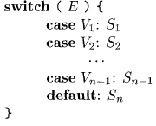
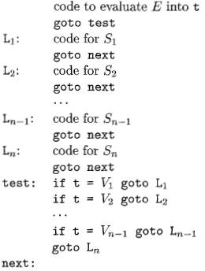
Translation of a switch-statement(CO3)

Slide 84
Recap
Short Circuit Evaluation
Three address code for switch case

Slide 85
Topic Objective(CO3)
Introduce students to the concepts of back patching which gives the real algorithmic idea to generate three address code

Slide 86
Back Patching(CO3)
Previous codes for Boolean expressions insert symbolic labels for jumps
It therefore needs a separate pass to set them to appropriate addresses
We can use a technique named back patching to avoid this
We assume we save instructions into an array and labels will be indices in the array
For non-terminal B we use two attributes B.true list and B.false list together with following functions:
makelist(i): create a new list containing only I, an index into the array of instructions
Merge(p1,p2): concatenates the lists pointed by p1 and p2 and returns a pointer to the concatenated list
Backpatch(p,i): inserts i as the target label for each of the instruction on the list pointed to by p

Slide 87
Back Patching for Boolean Expressions(CO3)

Slide 88
Recap
Backpatch
makelist(i): create a new list containing only I, an index into the array of instructions
Merge(p1,p2): concatenates the lists pointed by p1 and p2 and returns a pointer to the concatenated list
Backpatch(p,i): inserts i as the target label for each of the instruction on the list pointed to by p

Slide 89
Faculty Video Links, Youtube & NPTEL Video Links and Online Courses Details
Youtube/other Video Links
https://www.youtube.com/watch?v=nIMBA0qO684
https://www.youtube.com/watch?v=M8oQmaAfoJM
https://www.youtube.com/watch?v=yFVCw0N0nxo
https://www.youtube.com/watch?v=Bqq26obqUoU
https://www.youtube.com/watch?v=queUceGJqh0
NPTEL
https://youtu.be/MO5MGYm4v0o
https://youtu.be/7Z2VHWLJVSA
https://youtu.be/EpAzj7zXrbk
https://youtu.be/M-wIosep5Zs

Slide 90
Daily Quiz
What are the various types of three address statements?
a. Assignment Statement
b. Copy Statement
c. Assignment Instruction
d. All of the above
A "Three Address Code" consists of
a. Two operand and one result
b. Two operands and operator
c. One operand and two operators
d. None of d above.
Expressions that govern the flow of control that may be Boolean expressions containing _________ and _________ operators.
a. Arithmetic & logical
b. Relational & logical
c. Arithmetic & relational
d none of the above

Slide 91
Daily Quiz
Listing pointers to triples, rather than listing triples themselves is implementation of
a. Quadruple
b. Triple
c. Indirect Triple
d. Three address code
Quadruple is a record structure with four fields.
a. Op, arg1, arg2 and result
b. op1, op2, agr2 and result
c. agr1, arg2 , result and op
d. All of d above

Slide 92
Weekly Assignment
What are Synthesized and Inherited Attributes? [CO3]
Write the algorithm for moving forward pointer in "input buifering" scheme. [CO3]
What is the use of intermediate code during compilation? [CO3]
Explain the process of translating an assignment statement. [CO3]
What are different ways to write three address code ? [CO3]
Write the three address code for the following code segment [CO3]
WhileA<Cand B<D do
If A=l then C = g+l
else while A < = D do A= A+ 2.

Slide 93
Weekly Assignment
7. Define Syntax Directed Translation. Construct an annonated parse tree for the expression (4 * 7 + l) + 2, using the simple desk calculator grammar [CO3]
8. Define backpatching and semantic rules for boolean expression. Derive the three address code for the following expression [CO3] P<Q and R<S and T<Q
9. Generate tlree address code for the following code segment : [CO3]
While (a<b) do
if(c<d) then x=y+z
10.What is postfix translation ? Esplain it with zuitable example. [CO3]

Slide 94
MCQ s
In an L-attributed SDD , attributes may be inherited or synthesized.
a) True
b) False
Notations for associating semantic rules with productions are-------------------.
a) Syntax directed definition
b) Translation scheme
c) Both a and b
d) None of the above
The translation of token stream is result obtained by evaluated the
a) Productions
b) Syntax rules
c) Semantic rules
d) None of these

Slide 95
MCQ s
Terminals can have synthesized attributes but not inherited attributes.
a) True
b) False
An SDD without side effects is called
a) Context free grammar
b) Operator grammar
c) Attribute grammar
d) Both a and c
An SDD that involves only synthesized attributes is called-------------------.
a) S-Attributed
b) L-Attributed
c) Both a and b
d) None of the above
---------------- are useful tool for determining an evaluation order for the attribute instances in given parse tree.
a) DAG
b) Dependency graph
c) Graph coloring graph
d) None of these

Slide 96
Glossary Questions
Explain syntax directed translation with example?
Explain three address coding system and its implementation by example.
Notations for associating semantic rules with productions are-------------------.
a) Syntax directed definition
b) Translation scheme
c) Both a and b
d) None of the above
The translation of token stream is result obtained by evaluated the
a) Productions
b) Syntax rules
c) Semantic rules
d) None of these

Slide 97
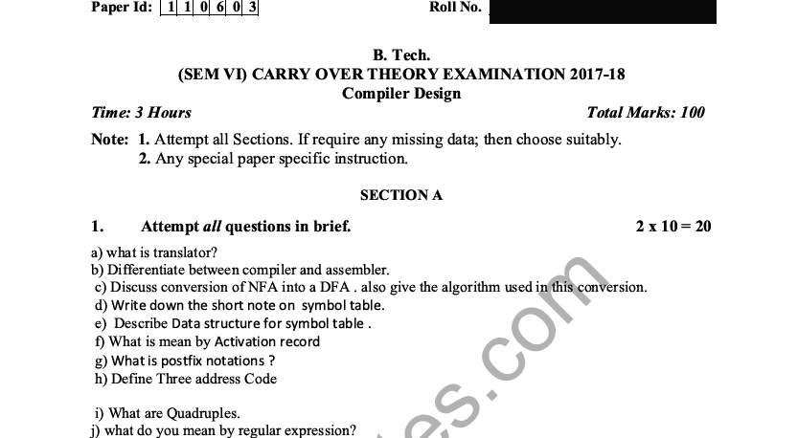
Old Question Papers

Slide 98
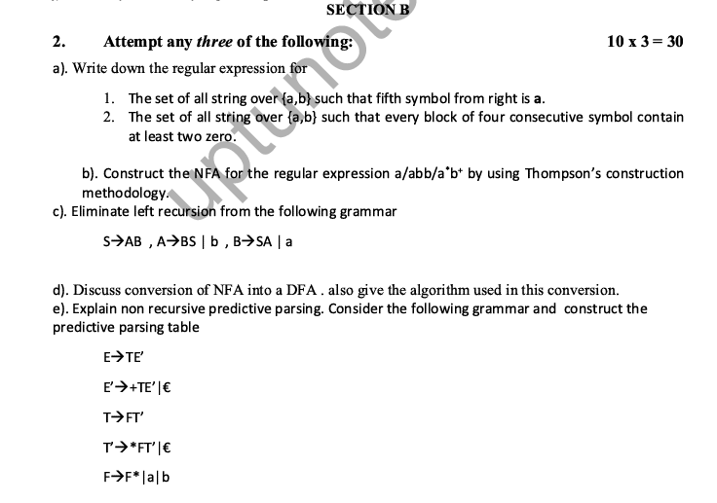
Old Question Papers

Slide 99
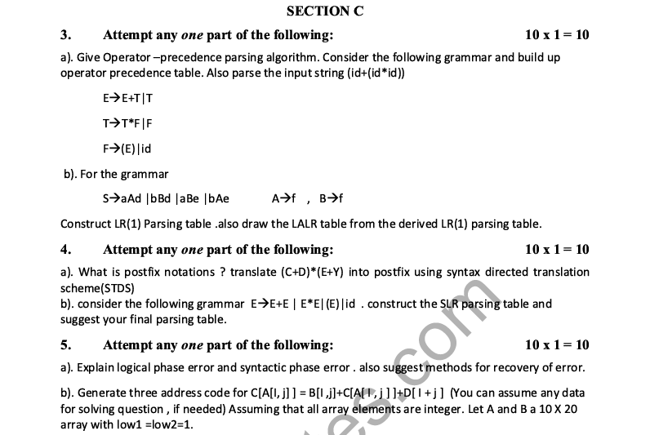
Old Question Papers

Slide 100
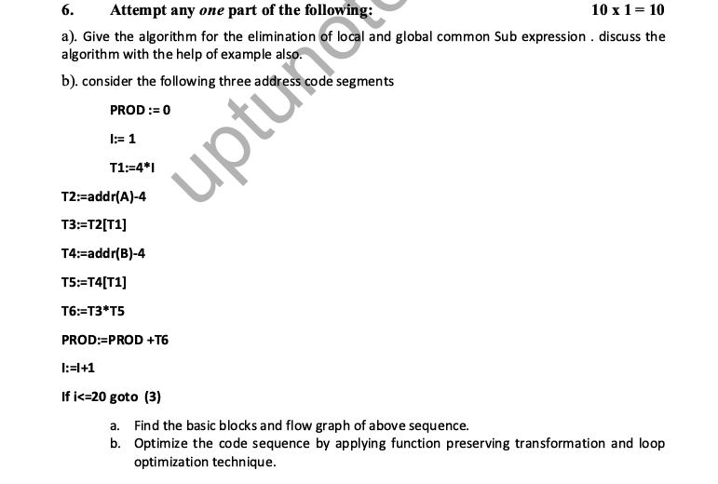
Old Question Papers

Slide 101
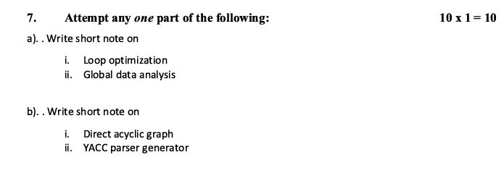
Old Question Papers

Slide 102
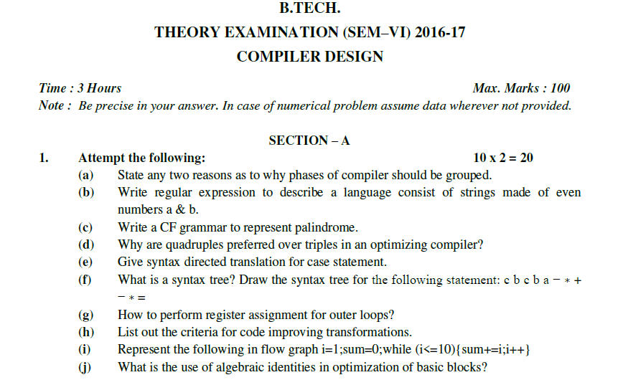
Old Question Papers

Slide 103
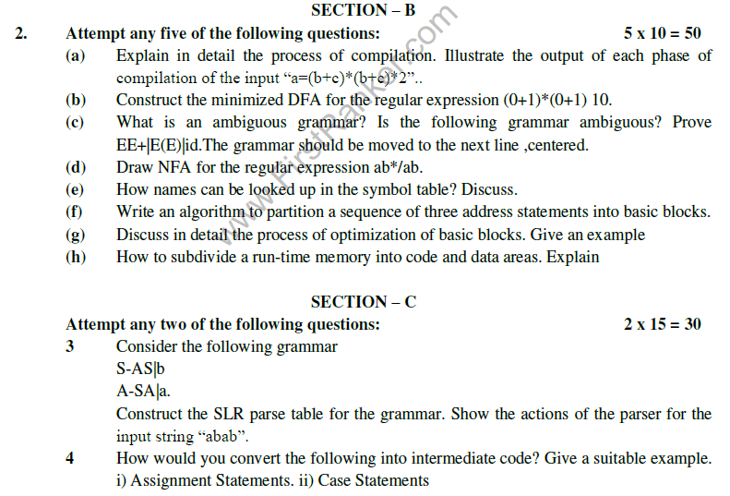
Old Question Papers

Slide 104
Old Question Papers

Slide 105
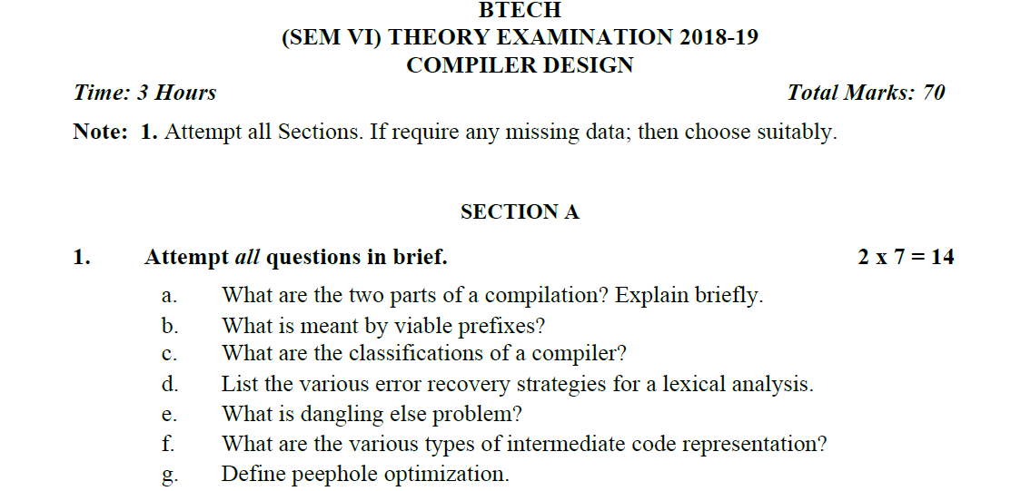
Old Question Papers

Slide 106
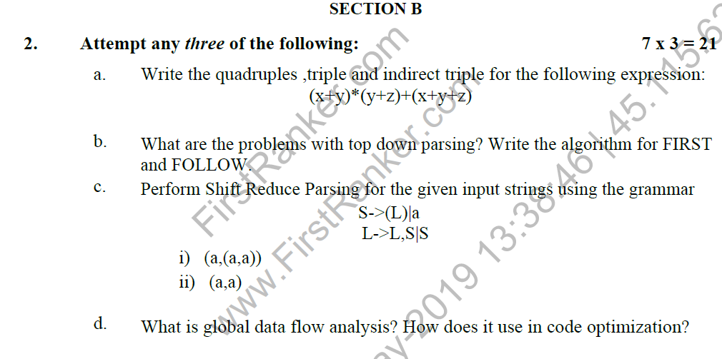
Old Question Papers

Slide 107
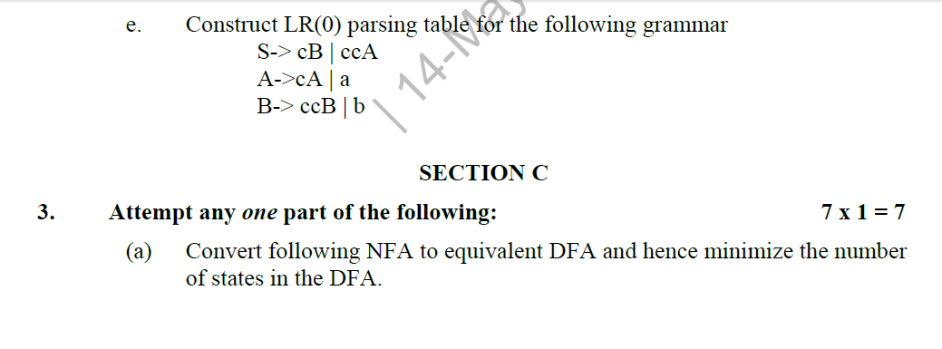
Old Question Papers

Slide 108
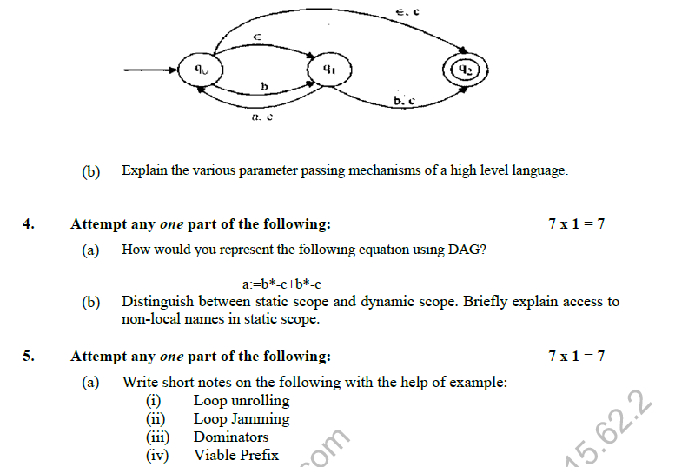
Old Question Papers

Slide 109
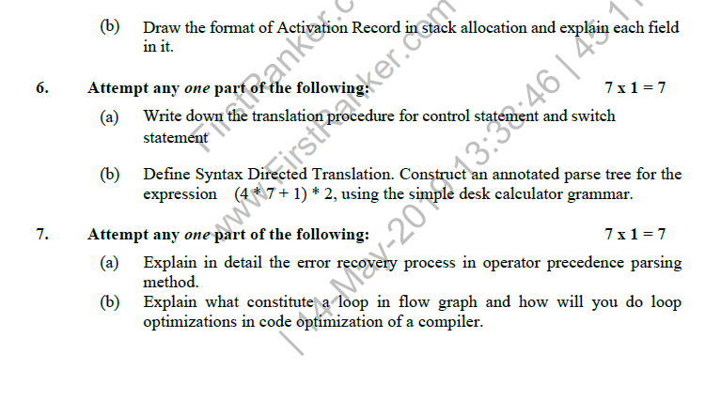
Old Question Papers

Slide 110
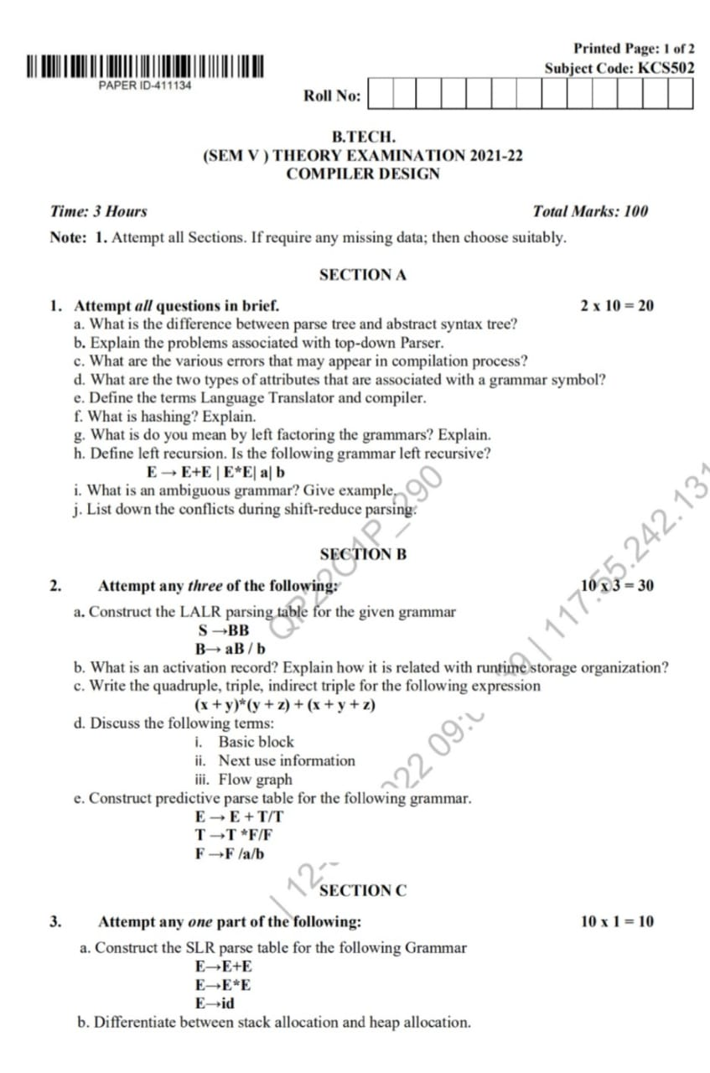
Old Question Papers

Slide 111
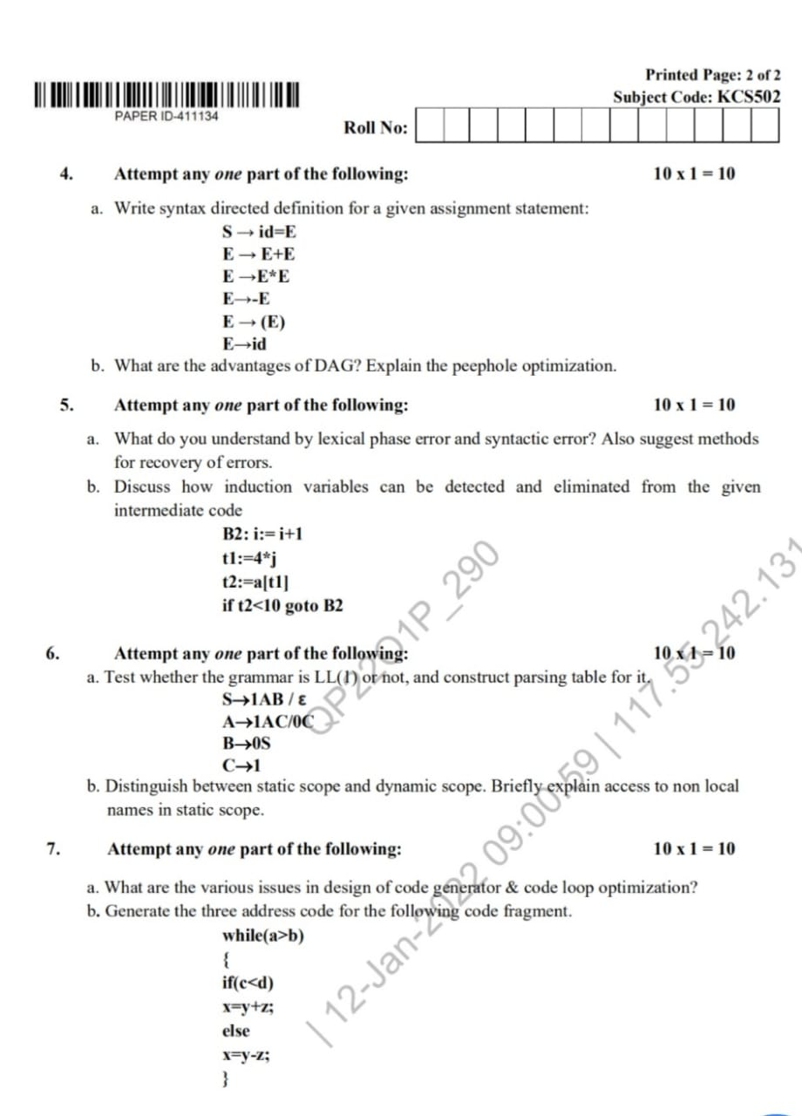
Old Question Papers

Slide 112
Expected Questions for University Exam
Explain syntax directed translation with example?
Explain three address coding system and its implementation by example.
Consider the Boolean expression x > y or ( z > k and not r < s). This expression can be parsed by using the following grammar and a marker for back patching. Build up the parse tree. Write the semantic actions for the grammar. Generate the intermediate code of expression using following grammar.
B→ B or B
B→ B and B
B→ not B
B→ (B)
B→ id
B→ id relop id

Slide 113
Expected Questions for University Exam
While (a<=b)
{
If (x<=y)
{
w= x + y * z ;
a ++;
}
Else
{
w=x-y;
b --;
}
}
Consider the above program fragment and answer the following question.
(i) Write control flow representation in postfix notation.
(ii) Write three address notations.

Slide 114
Recap of Unit
A syntax-directed translation is defined by associating a translation rule with each grammar rule.
A translation rule defines the translation of the left-hand-side nonterminal as a function of the right-hand-side nonterminals' translations, and the values of the right-hand-side terminals.
To compute the translation of a string, build the parse tree, and use the translation rules to compute the translation of each nonterminal in the tree, bottom-up; the translation of the string is the translation of the root nonterminal.

Slide 115
References
Principles of Compiler Design Textbook by Alfred Aho and Jeffrey Ullman
Principle of Compiler Design, A.V.Aho, Rabi Sethi, J.D.Ullman.
Compilers: Principles, Techniques and Tools A.V.Aho, Monica S. Lam, Rabi Sethi, J.D.Ullman
https://www.geeksforgeeks.org/compiler-design-tutorials/
https://www.javatpoint.com/compiler-tutorial
https://www.tutorialspoint.com/compiler_design/index.htm
https://nptel.ac.in/courses/106105190/

Slide 116
Noida Institute of Engineering and Technology, Greater Noida
Thank You

